Slide 1

Welcome to Viscount Beaumont’s C of E Primary School

Slide 2

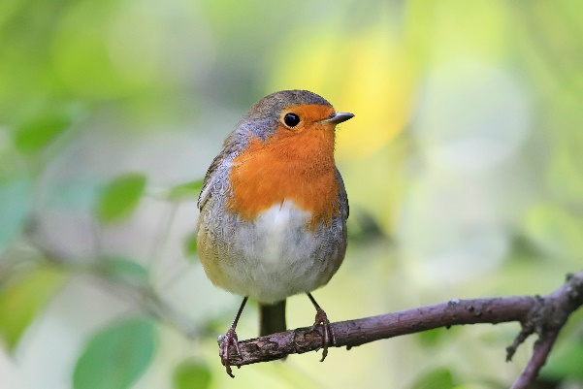
Who is who?
Robins Class
Class Teacher: Mrs Smith
Executive Headteacher: Mr McLugash

Slide 3

The School Day- AM
8.40 - Line up along the fence leading to Robin’s gate
8:50 – Register
9:00 – Collective Worship
9:30 – Literacy
10.20 – Break time
10:35 – Phonics
11:00 – practical learning and focus groups
11:30 – Maths
11:50 – story and hand wash
12:00 - lunchtime

Slide 4

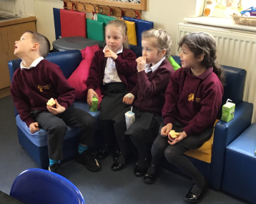
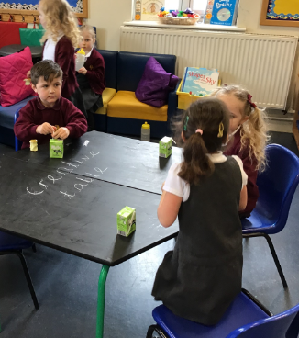
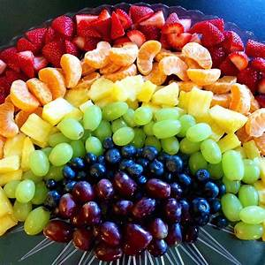
Morning Snack
During the morning your child will be able to have a drink of milk or water and eat a healthy snack.

Slide 5

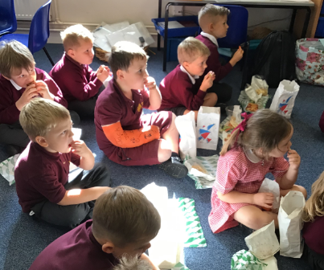
Lunch Time
Hot dinner or packed lunch?
We are lucky enough to have our own kitchen and so all food is fresh and hot!
Your child is entitled to a free hot dinner. We sometimes have special dinners for different occasions, even picnics outside!

Slide 6

A School Day- PM
My World, Your World
Into the Woods
Frozen Planet
Kings and Queens
Growing and Changing
Wheels in Motion.
1.00 – Register and topic learning
1:30 – practical learning and focus groups
2:30 – gross motor and fine motor skills
3:00 – Story and getting ready for home
3.15 – Home time

Slide 7

Class Dojo
Keep an eye on the ‘class story’ and the ‘school story’ to see any pictures or videos about what fun your child has been having at school!

Slide 8

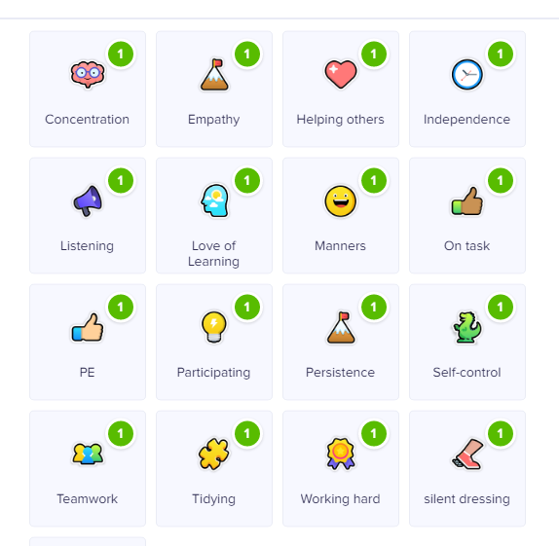
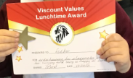
Celebrations
Notes:
When your child does some fantastic learning they will earn Dojo points – these can be for a range of reasons such as remembering their manners, persevering, for super tidying, being helpful, working hard and good listening. These Dojo points can be seen by grown-ups at home and will earn treats and surprises for the class at school!
Every week one member of the class will earn a ‘Viscount Values’ certificate and one member will earn a lunchtime award. The children will be split into 4 houses across the school (that they will stay in all the way to the end of Year 6). If your child earns a certificate they earn points for their house. We announce the winner at the end of each half term which is always super exciting!

Slide 9

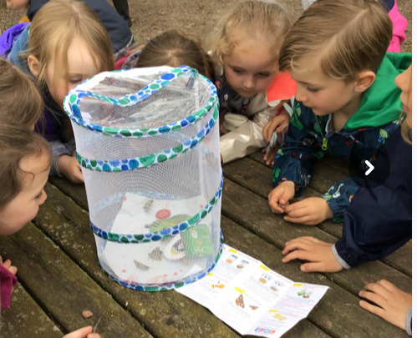
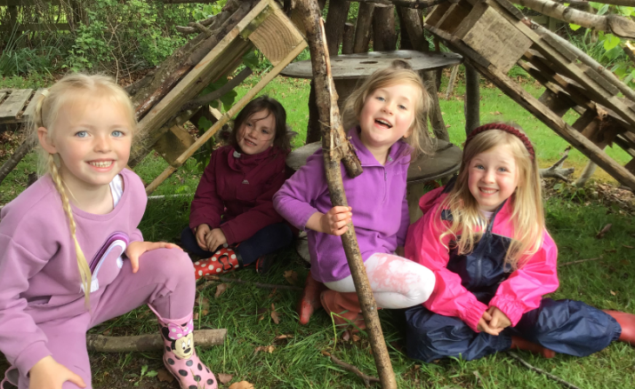
Forest School
‘Forest School is an inspirational process that offers ALL learners regular opportunities to achieve and develop confidence and self-esteem through hands-on learning experiences in a woodland or natural environment with trees’.
(Forest School Association)

Slide 10
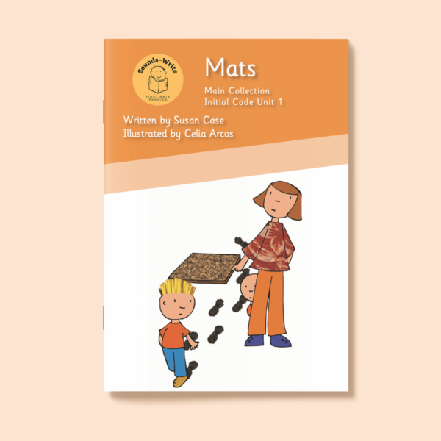
Homework?
Reading 4 times a week which will start with practising our initial sounds and listening to books read to them by a grown up.
Weekly round up on Class Dojo
Optional Numbots

Slide 11

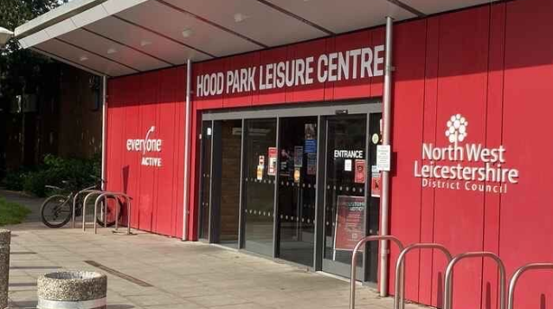
Before and After School Club
Before school -
From 7:30am
After school -
3:15pm – 4:30pm
Then at Hood Park in Ashby until 6pm

Slide 12

Autumn Term
Monday 24th August
9 -11:45am
Tuesday 25th August
9 – 1pm
Wednesday 26th August and onwards
Full days – 8:40 – 3:15pm

Slide 13

Any questions?
If you think of anything, please ask any of us. We will always endeavour to answer or find out the answer for you.

